Slide 1
Expenditure Data Analysis

Slide 2
Objective :
Development of a Sales insight Dashboard for enabling sales teams and managers to assess performance against their goals and objectives in real time.
Benefits:
Performance Management
Optimise Sales Activities
Inventory Management
Better Sales Performance
Better Decision Making

Slide 3
Data Collection :
A organization holds the huge amount of historical Data . A data can be in any Format.
Data Cleaning:
Data Cleaning is the most important part . A organization stores Data in many format such as in SQL server , Excel , CSV etc
The Tools used like Pandas , Numpy , Excel for Data Cleaning.

Slide 4
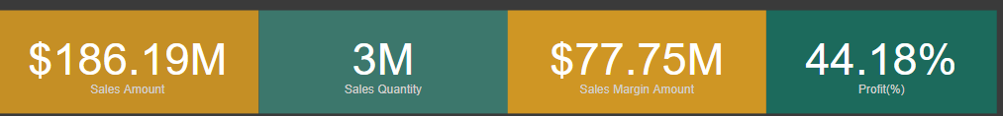
Dashboard:
The Dashboard contains the expenditure of company on the basis of historical data.
It includes several things:
1 . Growth :
Sales Amount : It includes the total Sales amount of the Company.
Sales Quantity : The total product sell by the company.
Sales Margin Amount : The total Margin on products.
Profit(%) : The Average Profit of the Company.

Slide 5
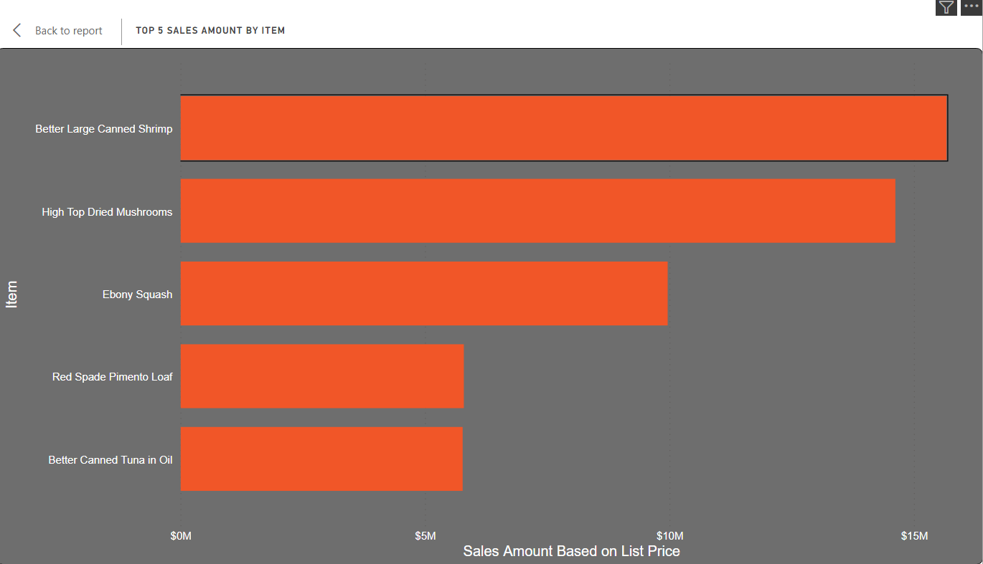
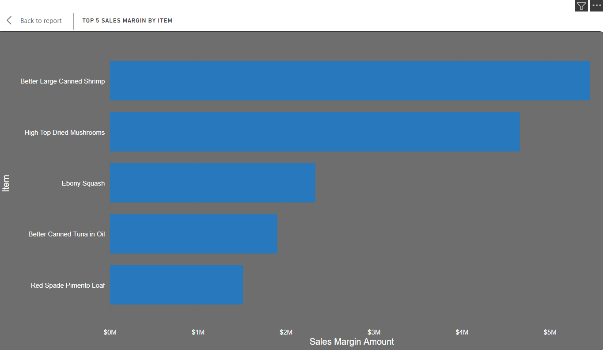
2 : Top 5 selling Product:
This Visual Chart contains of Top 5 selling product on the basis of there sales amount. The Dataset columns used is Sales Amount and Item which contains the product name and sales amount.
3 . Top 5 Sales Margin by item:
The chart contains the Margin amount of the Top 5 products.

Slide 6
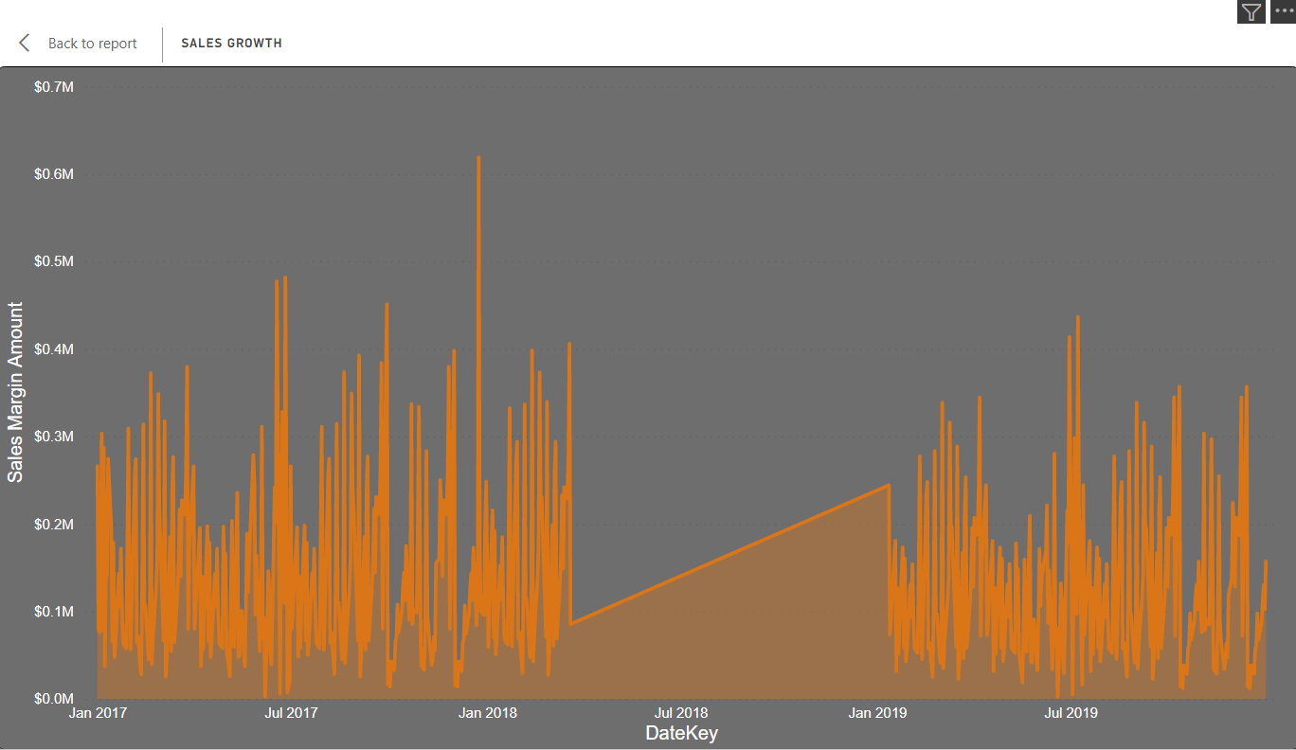
3. Sales Gwowth:
The Graph shows the overall growth of the company on the basis of their Sales Amount,
The graph can be visualize in Yearly , Monthly and Quarterly , which helps to understand the
Growth of the company more precisely.

Slide 7
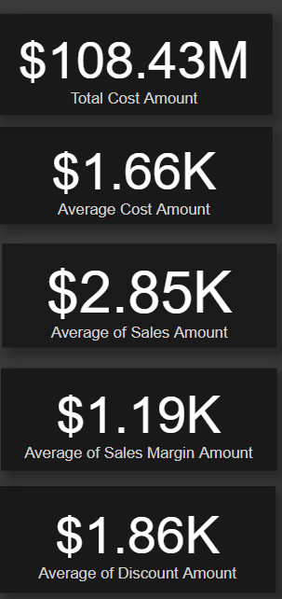
4. Cost Amount and Discount :
1 . Total Cost Amount : It shows the overall cost Amount of the product
2 . Average Cost Amount : It shows the Average Cost amount per product.
3. Average Sales Amount : it shows the Average Sales Amount Per Product.
4.Average Sales Margin Amount : It shows the Average Margin amount per product
5 . Average Discount Amount : It shows the
Average Discount Amount on product.

Slide 8
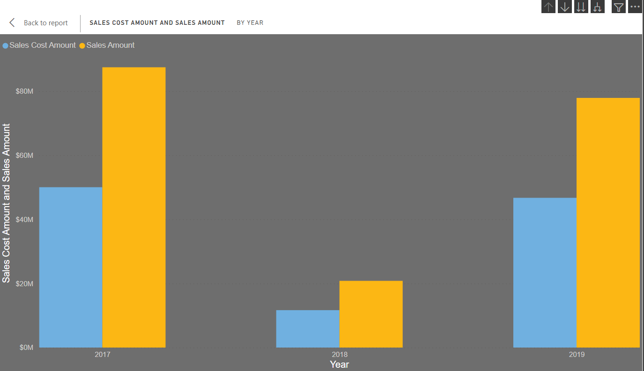
5. Cost and Sales Amount :
This is the most important chart which compare the total cost and sales amount
of the company and we can easily visualize the data yearly , monthly and Quarterly.
That helps the company to understand and think over the proper strategy.

Slide 9
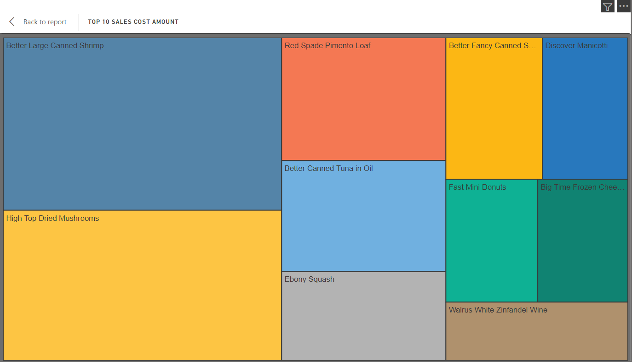
6. Top 10 Costly product:
The chart shows the Top 10 costly product on the basis of their sales amount.
Which helps the company to thick over there Costly product and there sales Amount.

Slide 10
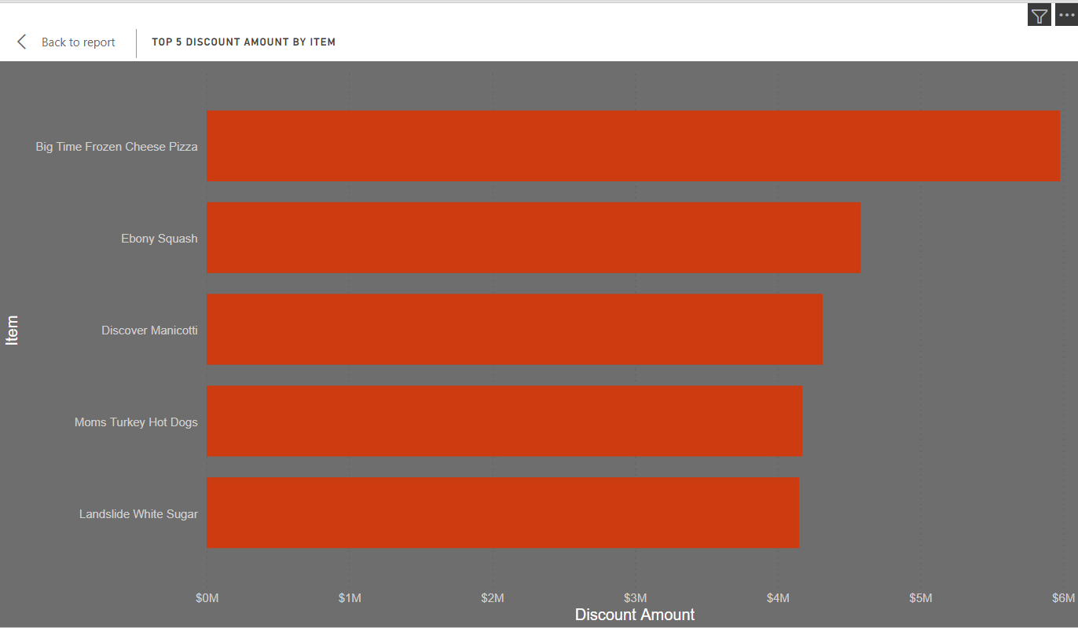
7. Discounted product:
The Chart shows the Top 5 Discounted product.

Slide 11
FAQ
Q1) What’s the source of data?
The data is provided by the company that contains the historical data and past performance
of company
Q 2) What was the type of data?
The data was the combination of numerical and Categorical values.
Q 3) What techniques were you using for data pre-processing?
Removing unwanted attributes
Visualizing relation of independent variables with each other and output variables
Checking and changing Distribution of continuous values
Removing outliers
Cleaning data and imputing if null values are present.
Converting categorical data into numeric values.

Slide 12
Q 4) How Dashboard is created.
The Dashboard is created by analysing the past performance of the company
and creating meaning insights by showing relationship between attributes.
Q 5) Deployment
To deploy content between stages, users need to have either member or admin permissions for both stages. Make sure that only the people you want deploying to production, will have production workspace permissions. Other users can have production workspace contributor or viewer roles.

